Slide 1

Enset DE Mohammedia- Master
II-BDCC
Année universitaire 2023/2024
MLOPS – Research and Developpment Environment
Abdelwahab Naji - Enseignant chercheur
Abdelwahab.naji@gmail.com
ENSAO, Université Mohamed premier - Oujda
https://www.youtube.com/c/AbdelwahabNaji

Slide 2
how to learn machine learning well
If you can’t implement it, then you don’t understand it
How to practice
Recall: this is a hands-on course
Get your hands dirty!
Concepts
Code
Remember: a real job / project involves actually writing code

Slide 3
MLOPS- Research and Developpment Outlines
Data Analysis pipline
Feature Engineering pipeline
Feature Selection pipeline
Model Training pipeline
Scoring pipeline

Slide 4
Machine Learning Project end to end
1. Data set

Slide 5
Machine Learning Project end to end
2. Data Preprocessing: handling missing values, dealing with outliers, standardizing or normalizing features, encoding categorical variables, and other data transformations to ensure that the data is suitable for modeling.
Allows to an algorithm ML the ability of interpreting easily the data's features
3. Exploration and Data Analysis (EDA): examining and analyzing the dataset to gain insights and a better understanding of its characteristics.
Visualizing data, calculating statistics, identifying patterns, and exploring relationships within the dataset
Inform feature selection, model choice, and data preprocessing decisions
4. Feature Engineering: creating, selecting, or transforming input features (characteristics) to improve a model's performance.
Designing relevant and informative input data for machine learning algorithms
And then possibly have a model more accurate and precise in predictions

Slide 6
Machine Learning Project end to end
5. Model Selection: this step involves choosing the appropriate machine learning algorithm or model architecture based on the nature of the task and dataset.
This step is critical for achieving optimal model performance and accuracy.
6. Model Training: involves using a selected algorithm to fit the model to the training data, adjusting its parameters to minimize a specified loss function.
This process allows the model to learn patterns and relationships in the data and become capable of making predictions
7. Model Evaluation: assesses the performance of a trained model using independent test or validation data
This step helps determine how well the model generalizes to unseen data
For Classification Task: Measuring its accuracy, precision, recall, F1 score, or other relevant metrics .
For Regression Task: Measuring its MSE, RMSE, or other relevant metrics.
8. Model Optimization: involves fine-tuning the model's hyperparameters, architecture, and training process to improve its performance, typically based on evaluation results.
This iterative process aims to enhance the model's predictive power and generalization capabilities for better results on unseen data.

Slide 7
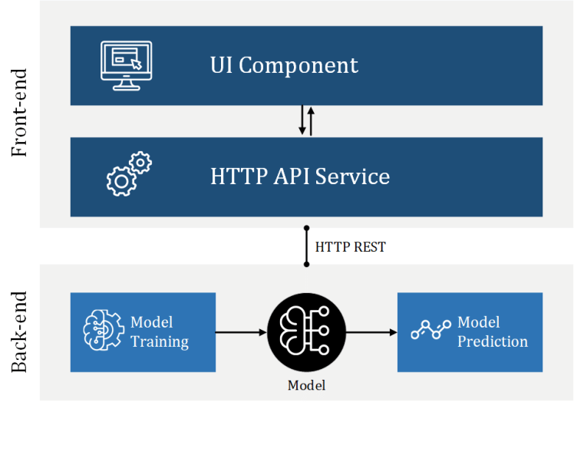
Machine Learning Project end to end
9. Model Deployment: involves integrating the trained model into a production environment or system, making it available for real-time predictions or decisions.
This step ensures that the model can be used to address the intended problem in practical applications
Involves creating APIs or software interfaces for its seamless integration.

Slide 8
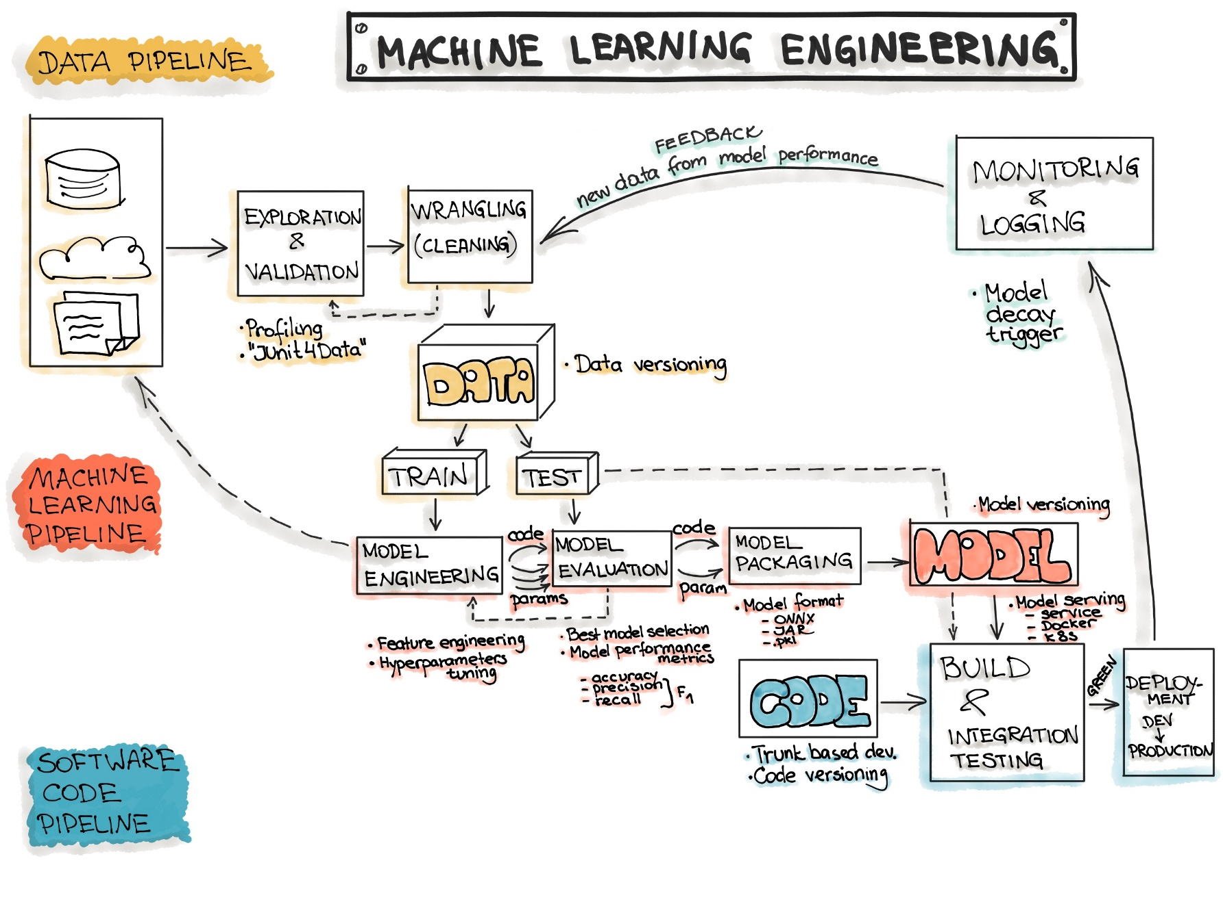
Machine Learning Project end to end workflow
Example 1
https://ml-ops.org/content/end-to-end-ml-workflow

Slide 9
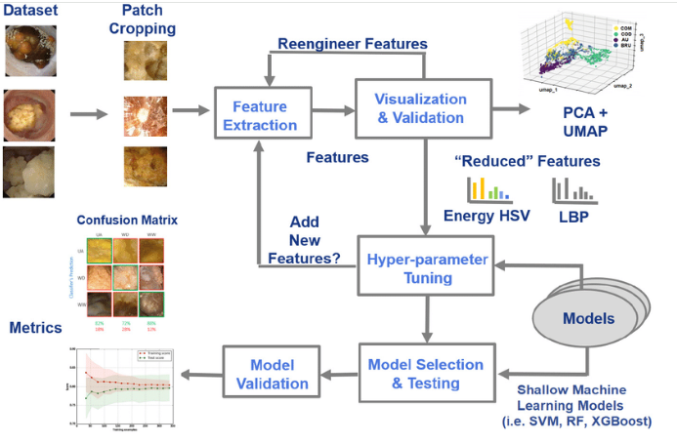
Machine Learning Project end to end workflow
Example 2
https://www.researchgate.net/figure/Illustration-of-the-training-of-the-six-shallow-machine-learning-models-feature_fig3_358144402

Slide 10
Application
Prediction Sale Price of Houses

Slide 11
how to carry out the project?
work on two different environments
Research and Development Environment
Production Environment
Represents the operational and real-world deployment phase where the trained machine learning model is integrated into a system or application to provide predictions.
Librairies
Configurations
.py files
…
Represents a dedicated space and infrastructure where researchers and data scientists can experiment, innovate, and explore new techniques and approaches to advance the project's goals.
Use notebook to

Slide 12
Observe the structure of the notebook file
Import dependencies
Research Environment/ Jupyter notebook code
Local training data
Prep train/ test data
Config
Data preprocessing Pipeline
https://scikit-learn.org/stable/modules/preprocessing.html
Train model
Evaluate the model
Persist the model
Score new data

Slide 13
Data set
Objective: predict SalePrice of houses
house-prices dataset
Download the data set from kaggle: https://www.kaggle.com/c/house-prices-advanced-regression-techniques/data
Download the train.csv & test.csv
Explore rows and columns
Shape: (1460, 81)
79 predictive variables and 1 target variable

Slide 14
Data set- columns
Predictible variable
Target variable
id
MSSubClass
MSZoning
LotFrontage
LotArea
Street
Alley
LotShape
LandContour
Utilities
LotConfig
LandSlope
Neighborhood
Condition1
Condition2
BldgType
HouseStyle
OverallQual
OverallCond
YearBuilt
YearRemodAdd
1. SalePrice
RoofStyle
RoofMatl
Exterior1st
Exterior2nd
MasVnrType
MasVnrArea
ExterQual
ExterCond
Foundation
BsmtQual
BsmtCond
BsmtExposure
BsmtFinType1
BsmtFinSF1
BsmtFinType2
BsmtFinSF2
BsmtUnfSF
TotalBsmtSF
Heating
HeatingQC
CentralAir
Electrical
1stFlrSF
2ndFlrSF
LowQualFinSF
GrLivArea
BsmtFullBath
BsmtHalfBath
FullBath
HalfBath
BedroomAbvGr
KitchenAbvGr
KitchenQual
TotRmsAbvGrd
Functional
Fireplaces
FireplaceQu
GarageType
GarageYrBlt
GarageFinish
GarageCars
GarageArea
GarageQual
GarageCond
PavedDrive
WoodDeckSF
OpenPorchSF
EnclosedPorch
3SsnPorch
ScreenPorch
PoolArea
PoolQC
Fence
MiscFeature
MiscVal
MoSold
YrSold
SaleType
SaleCondition
44 Categorical variables
35 numerical variables
Target is numeric

Slide 15
Part 1
Data Analysis pipeline

Slide 16
Data Analysis pipeline
In this part, we will analyse the following:
The target variable
Variable types (categorical and numerical)
Missing data
Numerical variables
Discrete
Continuous
Distributions
Transformations
Categorical variables
Cardinality
Rare Labels
Special mappings

Slide 17
Data Analysis pipeline
The target variable
Variable types (categorical and numerical)
Missing data
Numerical variables
Discrete
Continuous
Distributions
Transformations
Categorical variables
Cardinality
Rare Labels
Special mappings

Slide 18
1. Target variable analysis
What we need to knwo:
The type of the target variable (regression or classification)
Continus target
Distribution
Improve the spread of the target by appliying mathematical techniques: log transformation, power transformation, normalization, centering, custom transformation, scale change
Discrete: log transformation, power transformation, normalization, centering, custom transformation, ordinal Encoding, One-Hot encoding,
Categorial: One-Hot encoding, Label Encoding (in case of ordered values), Frequency Encoding, Embedding
Embedding: represents categorical data as continuous vectors, enabling models to capture relationships and similarities between categories
binary

Slide 19
Data Analysis pipeline
The target variable
Variable types (categorical and numerical)
Missing data
Numerical variables
Discrete
Continuous
Distributions
Transformations
Categorical variables
Cardinality
Rare Labels
Special mappings

Slide 20
2. Variables types
What we need to knwo:
identify categorical variables
identify numerical variables

Slide 22
Data Analysis pipeline
The target variable
Variable types (categorical and numerical)
Missing data
Numerical variables
Discrete
Continuous
Distributions
Transformations
Categorical variables
Cardinality
Rare Labels
Special mappings

Slide 23
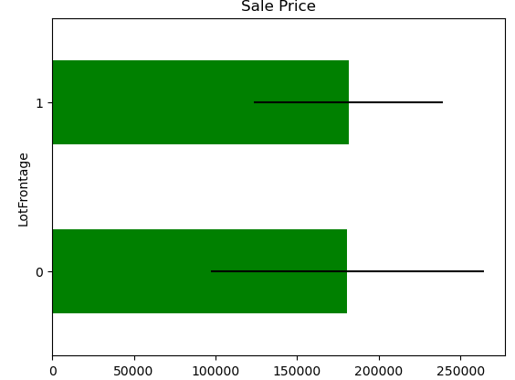
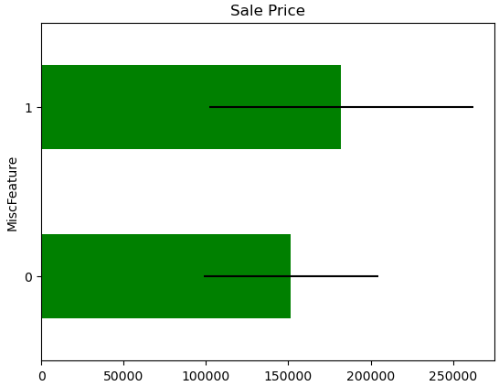
3. Missing Data
What we need to do:
How many variables has Nan values
Which variables have Nan
Which categorical variables have Nan
Which numericla variables have Nan
what is the percentage of null values for each variable
What is the relationship between missing data and Sale Price
how depends the output to variables with missing values are
What Numerical Variables we have in the dataset
Which information can we have form temporal variables
Find which variables are discrete and how can they influence the price
Find which variables are continuous and verify their distribution, and which transformation can be made

Slide 25
Data Analysis pipeline
The target variable
Variable types (categorical and numerical)
Missing data
Numerical variables
Discrete
Continuous
Distributions
Transformations
Categorical variables
Cardinality
Rare Labels
Special mappings

Slide 26
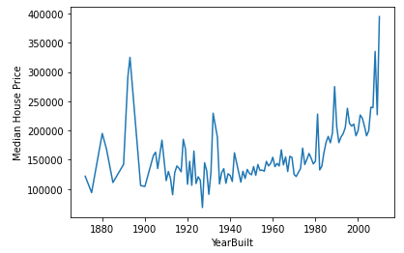
4. Numerical Data
What we need to do:
Which Numerical Variables we have in the dataset
Find which variables are temporal and how can they influence the price and which information can we have form them
Find which variables are discrete and how can they influence the price
Find which variables are continuous and verify their distribution, and which transformation can be made for each continuous variable
Find skewed variables and see how predictive they are

Slide 27
Data Analysis pipeline
The target variable
Variable types (categorical and numerical)
Missing data
Numerical variables
Discrete
Continuous
Distributions
Transformations
Categorical variables
Cardinality
Rare Labels
Special mappings

Slide 28
5. Categorical Variables
What we need to do:
Find skewed (asymmetric) variables and see how predictive they are
How many different categories are present in each categorical variable
Find which categorical variable are ordered and how can be encoded
Which labels are under-represented in the dataset and why we shood remove or replace them
Find the relationship between the categories of the different variable and the house sale price

Slide 29
5. Categorical Variables
Machine Learning Techniques & Categorical Data
Incode categorical data into numerical data before use them is a crucial step before modeling step
Some techniques can not work with categorical data directly: neural networks, knn, logistic regression, linear regression…
These techniques require transformations
Some techniques can work with categorical data directly: decision trees, random forest
But, Some implementations of machine learning algorithms require all data to be numerical like sklearn implementation

Slide 30
5. Categorical Variables
Ordinal Encoding for Oredered Categorical Data
Ordinal encoding
For example: size (XS,S,M,L,XL,XXL), the order have a sense
machine learning algorithms may be able to understand and harness this sense.
Example
import pandas as pnd
data = ['M','XL','M','XS','S','XS','S']
df = pnd.DataFrame(data, columns=['Size'])
scale_mapper = {"XS":1, "S":2, "M":3,"L":4,"XL":5}
df["Size"] = df["Size"].replace(scale_mapper)

Slide 31
5. Categorical Variables
One-Hot Encoding for Non Ordrered Categorical Data
One-Hot Encoding:
For example: color (red,green,blue), the order not make sense
Example
from numpy import asarray
from sklearn.preprocessing import OneHotEncoder
# define data
data = asarray([['red'], ['green'], ['blue']])
print(data)
print("---------------------------------")
# define one hot encoding
encoder = OneHotEncoder(sparse=False)
# transform data
onehot = encoder.fit_transform(data)
print(onehot)

Slide 32
Part 2
Features Engineering pipeline

Slide 33
Features Engineering pipeline
Separate data into train and test
How this separation allows us to avoid over-fitting
Fix the seed
Deal with missing data
For categorical variables
For numerical variables
Transform data
Categorical variables
Numerical variables
Temporal variables
Discrete variables
Deal with rare lables
Encode categoricla variable
Scale continuous variables
Save train and test data in new files

Slide 34
Part 3
Features Selection pipeline

Slide 35
Features Selection pipeline
A feature selection pipeline represents a systematic and automated process for selecting the most relevant features (input variables) from a larger set of features in a machine learning project.
This pipeline is a series of steps or components that are used to preprocess and choose the most important features before training a machine learning model.
Feature selection is essential for improving model performance, reducing overfitting, and enhancing interpretability.
Different feature selection algorithms, such as Recursive Feature Elimination (RFE), L1 regularization (Lasso), or forward/backward selection, are applied to choose the top-performing features based on their scores.

Slide 36
Part 4
Model Training pipeline

Slide 37
Model Training pipeline
Model Selection
Model Training
Model Tuning

Slide 38
Part 5
Scoring pipeline

Slide 39
Scoring pipeline
Test the model on data never seen

